Slide 1

Adobe Inc.
Submitted by :- Sumit Singh
Submitted to :- Dr. Sartaj Singh

Slide 2
Brief about company.
Adobe Inc., formerly (1982–2018) Abobe Systems Incorporated, American developer of printing, publishing, and graphics software. Adobe was instrumental in the creation of the desktop publishing industry through the introduction of its PostScript printer language. Its headquarters are located in San Jose, California.

Slide 3
Country of origin & Countries for business.
Country of Origin :- United States of America.
Country for business :-
There are lot of companies but few major are listed below.
US
India
China
Japan
Taiwan
Poland
England

Slide 4
Packages offered by company for roles
Some Packages for certain role provided by company
Computer ScientistExperience: 4 - 11
yrs (299 Salaries)
37,70,000/year ( 24.0L/yr - 55.5L/yr)
Software EngineerExperience: 1 - 5
yrs (263 Salaries)
15,10,000/year ( 8.0L/yr - 42.0L/yr)
Technical ConsultantExperience: 3 - 9
yrs (217 Salaries)
14,10,000/year ( 5.8L/yr - 23.5L/yr)
Senior Software EngineerExperience: 3 - 7
yrs (185 Salaries)
17,60,000/year ( 10.5L/yr - 34.0L/yr)
Lead Software EngineerExperience: 5 - 9
yrs (148 Salaries)
22,60,000/year ( 15.0L/yr - 32.0L/yr)

Slide 5
Year of Existence with History
The company was founded in 1982 by John Warnock and Charles Geschke. While employed at Xerox Corporation’s Palo Alto (California) Research Center (PARC), the two computer scientists had developed a programming language specially designed to describe the precise position, shape, and size of objects on a computer-generated page. This page description language, later known as PostScript, described such objects as letters and graphics in mathematical terms, without reference to any specific computer or printer; any device capable of interpreting the language would be able to generate a representation of the page at any resolution the device supported. When Xerox declined to bring the technology to market, Warnock and Geschke formed their own company to do so, naming it after a creek near their homes.

Slide 6
HTML5.
Technologies used in the Company
Google Analytics
jQuery

Slide 7
Major services by the company with clients
Creative Cloud All Apps. Get 20+ creative apps including Photoshop, Illustrator, Premiere Pro, Acrobat Pro and Adobe Express. ...
Acrobat Pro. The complete PDF solution for today's multi-device world.
Photoshop.
Premiere Pro.
Illustrator.
Adobe Stock.
Adobe Express. InDesign.

Slide 8
Digital media.
Operational verticles of the company with clients
Healthcare.
Software provider.
Financial services.
High Technology.

Slide 9
Software Engineer.
Roles you are interested with company.
Responsibilities
Execute full software development life cycle (SDLC)
Develop flowcharts, layouts and documentation to identify requirements and solutions
Write well-designed, testable code
Produce specifications and determine operational feasibility
Integrate software components into a fully functional software system
Develop software verification plans and quality assurance procedures
Document and maintain software functionality
Troubleshoot, debug and upgrade existing systems
Deploy programs and evaluate user feedback
Comply with project plans and industry standards

Slide 10
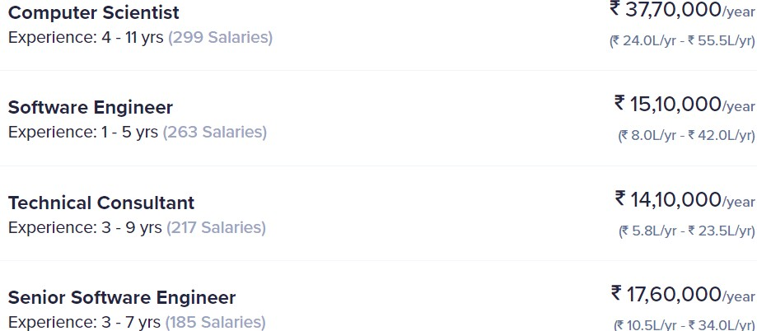
Packages offered by company for roles
Some Packages for certain role provided by company.

Slide 11
Visits company gave to LPU campus
Adobe never visit the LPU campus

Slide 12
Ranking of the company
( Forbes Fortune 500 etc.)
339 current rank
Previous rank 389

Slide 13
Employee Base. (Country wise)
US
New York
India
Noida
Mumbai
Bangalore
Europe
Poland
Switzerland
Sweden
•

Slide 14
Major product of the company with clients
Photoshop
Illustrator
InDesign
Adobe XD
Dreamweaver

Slide 15
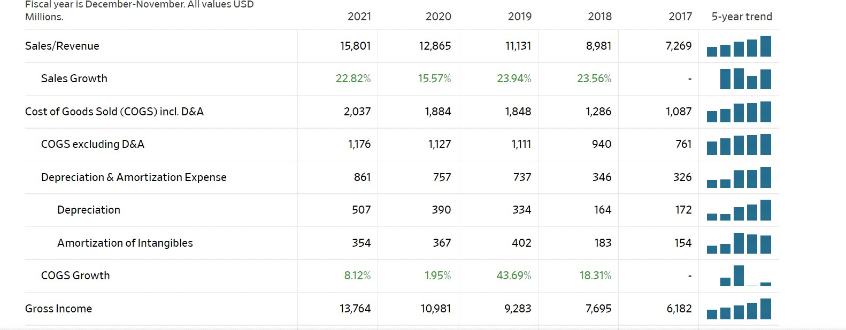
Revenue as per the NSE / NYSE ( Last 5 years)

Slide 16
Prosandconsofthecompanyyouhave consideredforyou.
Pros:
Youwilhaveanoptiontoselectyourdomain (SAP,JAVA,Dot
Net.etc).
Wilgetgo dtheoreticalandpracticaltraininginthat domainfor
nearly3months.
wilbegivenenoughatemptstoclearit:)

Slide 17
Cons:
Onceyoucompleteyourtrainingevenasatop erofthe batch.Insome
casesyoumightstayonbenchforyears.
Youwilgetaprojectop ortunitybasedonyourfortune oranyinfluence.
Ifyouarebenchforlongtimethenyouwilgetacalfrom higherofficials tosearchaprojectwithinagivenperiodorquit.Istilcan't gethowthe
helafreshercangetaprojectwithoutanyassistance.
Nowonceyougetaproject,don'texpecthatyouwilbe codingfrom
day1oratleastday365.youwilmostlyhavesup ortroles
youcanseeararecaseofdevelopers.Onceafterentering intoprojectif
youdon'tlikeitandwan aquitproject.Thenyouwil

Slide 18
experiencePoliticsof ITindustry.
you'lhaveahelofassessmentseveryyearwhichyou might

Slide 21
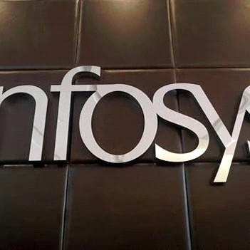
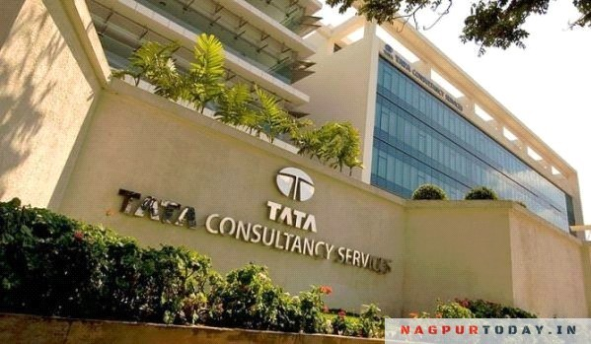
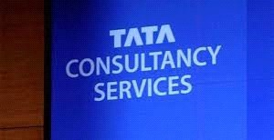
ServiceBasedCompany
Aservice-basedcompanyistheonethat providescustomers,clientstheultimate solutiontotheirequirementsoraserviceto

Slide 22
anothercompany.Theserviceoferedbythe companyisintangibleandcanbeprovidedin theform ofskils,amenities,andexpertise

Slide 23
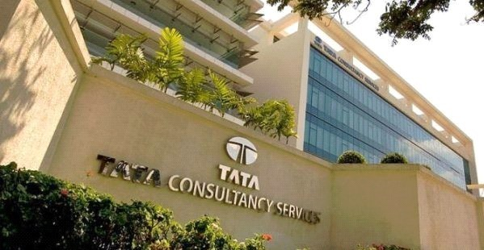
TataConsultancyService
TataConsultancyServices(TCS)isanIndian multinationalinformationtechnology(IT)services andconsultingcompanywithitsheadquarters inMumbai.ItisapartoftheTataGroupand operatesin150locationsacros46countries.TCS isthesecondlargestIndiancompanybymarket capitalizationandisamongthemostvaluableIT servicebrandsworldwide.

Slide 24
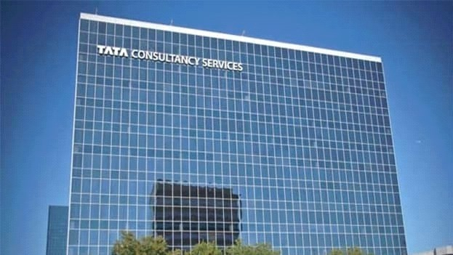
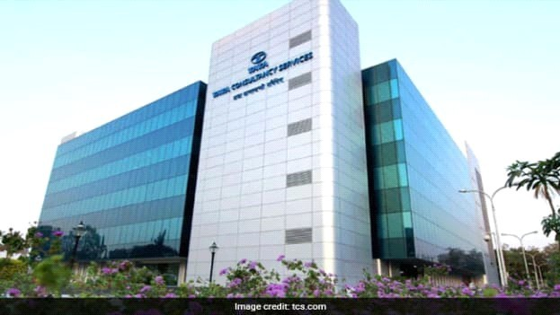
YearsofExistence
TataConsultancyServicesLimited,initialy startedasTataComputerSystems,was foundedin1968byadivisionofTataSons Limited.Itsearlycontractsincludedpunched cardservicestosistercompanyTISCO (nowTataStel),workingonanInter-Branch ReconciliationSystem fortheCentralBankof IndiaandprovidingbureauservicestoUnit TrustofIndia.

Slide 25
CountryofOrigin&
CountriesforBusines
WithitsheadquartersinMumbai,Tata ConsultancyServices(TCS)isamultinational IndianproviderofITservicesandconsulting. Itworksin150locationsthroughout46 countriesandisapartoftheTataGroup. Accordingtoareportfrom July2022,TCS employedmorethan600,000people worldwide.TCSisoneofthemostvaluableIT servicebrandsintheworldandthesecond- largestIndiancorporationintermsofmarket capitalization.TCS,oneofthetop-ranked IndiancorporationsandanITservices provider,wasranked64thoveralinthe

Slide 26
Forbeslistofthe"World'sMostIn ovative Companies"in2015.Itislistedasnumber11 ontheFortuneIndia500listasof2018.TCS becamethefirstIndianITbusinesstocross
$100bilioninApril2018.
RevenueaspertheNSE/ NYSE(Last5years)
TataConsultancyServices
PreviousYears»
StandaloneYearlyResults -------------------inRs.Cr.-------------------
 |  | Mar'2 | Mar'21 | Mar'20 |  | Mar'19 |  | Mar'18
NetSales/Incomefrom operations OtherOperatingIncome TotalIncomeFrom Operations |  | 160,341.0 -- 160,341.0 | 135,963.0 -- 135,963.0 | 131,306.0 -- 131,306.0 |  | 123,170.0 -- 123,170.0 |  | 97,356.0 -- 97,356.0
EXPENDITURE
ConsumptionofRawMaterials -- |  |  | -- |  | -- |  | -- |  | --
PurchaseofTradedGo ds -- |  |  | -- |  | -- |  | -- |  | --
Increase/DecreaseinStocks -- |  |  | -- |  | -- |  | -- |  | --
Power&Fuel -- |  |  | -- |  | -- |  | -- |  | --
EmployeesCost 81,097.0 |  |  | 69,046.0 |  | 64,906.0 |  | 59,37 .0 |  | 51,49 .0
Depreciation 3,52 .0 |  |  | 3,053.0 |  | 2,701.0 |  | 1,716.0 |  | 1,647.0
ExciseDuty -- |  |  | -- |  | -- |  | -- |  | --
Admin.AndSelingExpenses -- |  |  | -- |  | -- |  | -- |  | --
R&DExpenses -- |  |  | -- |  | -- |  | -- |  | --

Slide 27
ProvisionsAndContingencies | -- | -- | -- | -- | --
Exp.Capitalised | -- | -- | -- | -- | --
OtherExpenses | 32,9 9.0 | 26,607.0 | 29,047.0 | 28,829.0 | 18,052.0
P/LBeforeOtherInc.,Int.,Excpt.Items&Tax | 42,723.0 | 37,257.0 | 34,652.0 | 3 ,248.0 | 26,158.0
OtherIncome | 7,486.0 | 5,40 .0 | 8,082.0 | 7,627.0 | 5,803.0
P/LBeforeInt.,Excpt.Items&Tax | 50,209.0 | 42,657.0 | 42,734.0 | 40,875.0 | 31,961.0
Interest | 486.0 | 537.0 | 743.0 | 170.0 | 30.0
P/LBeforeExceptionalItems&Tax | 49,723.0 | 42,120.0 | 41,9 1.0 | 40,705.0 | 31,931.0
ExceptionalItems | -- | -1,218.0 | -- | -- | --
P/LBeforeTax | 49,723.0 | 40,902.0 | 41,9 1.0 | 40,705.0 | 31,931.0
Tax | 1 ,536.0 | 9,942.0 | 8,731.0 | 10,640.0 | 6,690.0
P/LAfterTaxfrom OrdinaryActivities | 38,187.0 | 30,960.0 | 3 ,260.0 | 30,065.0 | 25,241.0
PriorYearAdjustments | -- | -- | -- | -- | --
ExtraOrdinaryItems | -- | -- | -- | -- | --
NetProfit/(Loss)ForthePeriod | 38,187.0 | 30,960.0 | 3 ,260.0 | 30,065.0 | 25,241.0
EquityShareCapital | 36 .0 | 370.0 | 375.0 | 375.0 | 191.0
ReservesExcludingRevaluationReserves | 76,807.0 | 74,424.0 | 73,9 3.0 | 78,523.0 | 75,675.0
EquityDividendRate(%) | 4,30 .0 | 3,80 .0 | 7,30 .0 | 3,0 0.0 | 5,0 0.0
EPSBeforeExtraOrdinary
BasicEPS | 103.24 | 82.78 | 8 .64 | 79.34 | 131.15
DilutedEPS | 103.24 | 82.78 | 8 .64 | 79.34 | 131.15
EPSAfterExtraOrdinary
BasicEPS | 104.34 | 82.78 | 8 .64 | 79.34 | 131.15
DilutedEPS | 103.24 | 82.78 | 8 .64 | 79.34 | 131.15
 |  | -- -- | -- -- | -- -- | -- --
 |  | -- -- -- | -- -- -- | -- -- -- | -- -- --
 |  | -- -- | -- -- | -- -- | -- --

Slide 28
LeadershipHierarchyoftheCompany
AsistantSystem EngineerTrainee
Aftergraduating,youwillbehiredbyTCSandasignedtotheroleofAsistant System EngineerTrainee,orASETrainee.Theinitialjobwhereyouwillgain themostexposuretosystem engineerworkisasanASEtrainee.
Youwillworkinthisroleforayear,oratleastsixmonths.AnAsistantSystem EngineerTraineeatTCSisthoughtogetanaveragean ualincomeof 3,36,87 IndianRupees.
AssistantSystem Engineer
YouwilbepromotedtoAsistantSystem Engineerafteroneyearof experienceasatrainee,whereyouhelpthesystem engineerwith tasksandprojects.Theworkandresponsibilitiesyouconductwil haveundergoneasignificantchange.
System Engineer
Itisthehighestpositionyoucanreachasanenginer.AfteryourtwoyearsofexperienceinTCS youwillbecomeasystem enginer,theonewhoperformsdirectlyundertheteam lead,tech consultantorprojectmanagerbasedonthediferentypesofcases.

Slide 29
ITAnalyst
After5to7yearsofexperienceandperformanceyouwillbepromotedintotheITanalyst.Here youwillnolongerbedoingthedevelopingjob,insteadyouwillanalysethesystem andgive sug estionsforthedevelopment.
AssistantConsultant
Ifyouhavemorethan7yearsofexperienceinTCS,thenyouwillbepromotedasAsistant consultant.TheroleandresponsibilityofanAssistantConsultantmaydiferbasedonthetypeof project.
AssociateConsultant
YoucanbecomeanAsociateconsultantafter10yearsofexperience,anditisfullyperformance based.AsTCSmainlyfocusedonITconsultancyservicestherearemorethanoneAssociate Consultants.
ConsultantandSeniorConsultant
TherolesofAsociateConsultantandConsultantaresimilar.Howeverthesalary,responsibilities andpowerofaconsultantisabithigherthantheAssociateconsultant.

Slide 30
PrincipalConsultant
Theroleistheprimeandsupremeauthorityinthetechnicalchaincommand.He/shewilleadand commandmanyconsultantsandalothetasksorclientsforeachconsultantbasedontheir performance.
Theresourceisresponsibletocommunicatewiththemanagerialteam andhigherauthoritieslike VicePresidentandCEO.

Slide 31
EmploymentBaseofTCS
�TCSisoneofthelargestprivate-sectoremployersinIndia.andthe fourth-largestemployer amonglistedIndianCompanies(afterIndianRailways,IndianArmy, andIndianPost).TCShas
crosedmorethan500,000employeesasof8July2021.Thenumber ofnon-Indian ationals
were21,282asof31March2013(7.7%).Theemployeecostsforthe FY2012–13wereUS$4.38
bilion,whichwasapprox.38% ofthetotalrevenueofthecompany forthatperiod.Inthefiscal
year2012–13,TCSrecruited69,728newstaf,ofwhom 59,276were basedinIndiaand10,452 werebasedintherestoftheworld.Inthesameperiod,therateof attritionwas10.6%.The
averageageofaTCSemployeeis28years.Theemployeeutilization rate,excludingtrainees,
fortheFY2012–13was82%.TCSwasthefifth-largestUnitedStates visarecipientin2008 (afterInfosys,Wipro,andMahindra).In2012,theTata-Group companies,includingTCS,were

Slide 32
thesecond-largestrecipientofH-1Bvisas.AsofJan2020,TCShas over4,00,000+employees.
Itistheworld'sthird-largestITemployerbehindIBM andHP.

Slide 33
RankingofTCS
�TataConsultancyServices(TCS)hasbecomethesecondmost valuablebrandinthe
ITservicessectorglobaly,whilefourotherIndiantechmajors havefirmlyestablished theirpositionamongthetop25ITservicesbrandstaly, acordingtoBrandFinance.
Acentureretainedthetitleoftheworld'smostvaluableand strongestITservices brand,boastingarecordbrandvalueofUSD36.2bilion,asper thereport.Thereport saidasIBM hasgonedowntothefourthrank,TCShasrisenup tothesecondspotin
theranking,folowing12percentgrowthyear-on-yearand24 percentsince2020,toa
brandvalueofUSD16.8bilion.

Slide 34
TechnologiesusedinTCS
Analytics
Mobility
Collaboration
Cloud
IoT
AugmentedReality
Blockchain
QualityEngineerandAutomation
DataandAnalytics
Infrastructure

Slide 35
MajorServiceprovidedbyTCS
�TCSofersaconsulting-led,cognitive-powered,integrated portfolioofbusiness, technology,andengineeringservicesandsolutions.Thisis deliveredthroughits uniqueLocationIndependentAgiledeliverymodel, recognizedasabenchmarkof
excelenceinsoftwaredevelopment.

Slide 36
OperationalVerticalsofTCS
TCSverticalunitsprovidetheirservicestoindustriesandmarketsin aparticulardomain.For
example, banking,retail,telecom,insurance,manufacturing,utilities,healthcare etc.
TCShorizontalaretheoneswhoseprimarygoalistosupporthe aboveverticals.Forexample, Mobility,DES,EnterpriseSolutionsetc.Theysupportintwoways: 1)HelpinimplementingsomePOCsforaprospectiveclientbyusing theirdomainexpertiseand
requiredskils.
2)Form apo loftrainedresourcesfordiferentskilsetswhocanbe deployedtothoseverticals
andsupportheirproject.
Oncethepo ledresourcejobisdoneinthevertical,thentheyare againbroughtbacktotheir
respectivehorizontals

Slide 37
RoleIam InterestedinTCS
CyberSecuritySpecialist
Cybersecurityspecialistareresponsibleforprovidingsecurityforanorganization’s overalITsystems.Theysearchforvulnerabilitiesinsoftware,hardware,networks,anddata centersanddesignstrategiesanddefensivesystemstoprotectagainstatacksandthreats. Cybersecurityspecialistsareindemandwithacontinuedgrowthprojectionandarobust salary.Thisprofessionwilcontinuetoevolveastechnologyadvancesandasnewsecurity
concerncontinuetodevelop.

Slide 38
PackageOfferedbyTCStoCyber securityspecialist
�AveragesalaryoferedtoITanalystin7LakhsINR.

Slide 39
Visitscompanygaveto LPUcampus
“YES”.WHILEMOSTSCHOOLSHAVEWILINGLYCHOSENTHEPATHOF ADVANCEMENT,WHENITCOMESTOHIGHEREDUCATION,THENUMBER OFUNIVERSITIESEMBRACINGTHEINTEGRATIONOFTECHNOLOGYINTHE IRLEARNINGMETHODSREDUCESSUBSTANTIALY.ONONEHAND,TOP PUBLICUNIVERSITIESAREYETTOUPGRADETHE IRINFRASTRUCTURE,WHILEONTHEOTHER,THEREAREFEW PRIVATE UNIVERSITIESTHATOFERACOMPLETEPACKAGEOFQUALITY TEACHING,INTUITIVELEARNING,ANDINDUSTRYTRAININGTO MINDFULYBUILDALOTOFSTUDENTSTHATCOMPANIESLIKEWipro ANDTCSLIKETOHIREFROM.

Slide 40
Prosandconsofthecompanyyouhave consideredforyou.
Pros:
Youwilhaveanoptiontoselectyourdomain (SAP,JAVA,Dot
Net.etc).
Wilgetgo dtheoreticalandpracticaltraininginthat domainfor
nearly3months.
wilbegivenenoughatemptstoclearit:)

Slide 41
Cons:
Onceyoucompleteyourtrainingevenasatop erofthe batch.Insome
casesyoumightstayonbenchforyears.
Youwilgetaprojectop ortunitybasedonyourfortune oranyinfluence.
Ifyouarebenchforlongtimethenyouwilgetacalfrom
higherofficials tosearchaprojectwithinagivenperiodorquit.Istilcan't gethowthe
helafreshercangetaprojectwithoutanyassistance.
Nowonceyougetaproject,don'texpecthatyouwilbe codingfrom
day1oratleastday365.youwilmostlyhavesup ortroles
youcanseeararecaseofdevelopers.Onceafterentering intoprojectif
youdon'tlikeitandwan aquitproject.Thenyouwil
experiencePoliticsof ITindustry.
you'lhaveahelofassessmentseveryyearwhichyou might

